Slide 1
Immune Response to Viral Infections
Dr Mohammed Shoeb
Assistant Professor
Department of Zoology
Govt. Dr WW Patankar Girl’s PG College, Durg

Slide 2
Introduction
A virus is a submicroscopic infectious agent that replicates only inside the living cells of an organism.
When infected, a host cell is often forced to rapidly produce thousands of copies of the original virus.
When not inside an infected cell or in the process of infecting a cell, viruses exist in the form of independent viral particles, or virions.
Virion consists of
(i) Genetic material which can be Single or Double Stranded DNA/RNA
(ii) A protein coat, the capsid, which surrounds and protects the genetic material; and in some cases
(iii) An outside envelope of lipids.

Slide 3
Virus infect organisms through
Vectors transmission
Droplet Infection
Sexual transmission

Slide 4
Immune Response to Virus
In response to the Virus infection host immune system activates an immune response.
This includes Innate immune response by cells and other mechanisms that protects the body by non specific mechanisms, and adaptive immune response by antibodies that neutralizes the virus.

Slide 5
Innate Immune response
The innate immune response to viral infection is primarily through the induction of type I interferon (IFN-α and IFN-β) and the activation of NK cells.
Double stranded RNA (dsRNA) produced during the viral life cycle can induce the expression of IFN-α and IFN- β by the infected cell, Macrophages, monocytes, and fibroblasts.

Slide 6
IFN-α and IFN-β can induce an antiviral response or resistance to viral replication by binding to the IFN / receptor. Once bound, IFN-α and IFN-β activate the JAK-STAT pathway, which in turn induces the transcription of several genes.
One of these genes encodes an enzyme known as 2-5-oligo-adenylate synthetase [2-5(A) synthetase], which activates a ribonuclease (RNAse L) that degrades viral RNA.

Slide 7
Other genes activated by IFN-α/β binding to its receptor also contribute to the inhibition of viral replication. For example, IFN- α/β binding induces a specific protein kinase called dsRNA-dependent protein kinase (PKR), which inactivates protein synthesis, thus blocking viral replication in infected cells.

Slide 8
The binding of IFN-α and IFN-β to NK cells induces lytic activity, making them very effective in killing virally infected cells. The activity of NK cells is also greatly enhanced by IL-12, a cytokine that is produced very early in a response to viral infection.

Slide 9
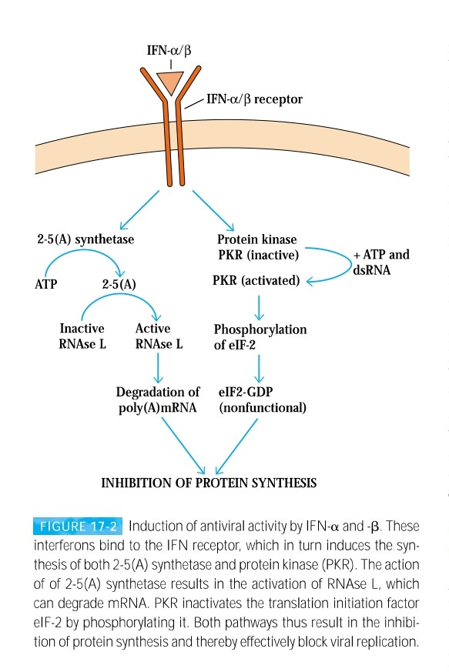

Slide 10
Antibody Mediated Immune Response
Antibodies specific for viral surface antigens are often crucial in containing the spread of a virus during acute infection and in protecting against reinfection.
Most viruses express surface receptor molecules that enable them to initiate infection by binding to specific host-cell membrane molecules.

Slide 11
For example, influenza virus binds to sialic acid residues in cell membrane glycoproteins and glycolipids; rhinovirus binds to intercellular adhesion molecules (ICAMs); and Epstein-Barr virus binds to type 2 complement receptors on B cells.
If antibody to the viral receptor is produced, it can block infection altogether by preventing the binding of viral particles to host cells.

Slide 12
Secretory IgA in mucous secretions plays an important role in host defense against viruses by blocking viral attachment to mucosal epithelial cells.
Antibodies may block viral penetration by binding to epitopes that are necessary to mediate fusion of the viral envelope with the plasma membrane.

Slide 13
Antibody of a complement-activating isotype causes lysis of enveloped virions. Antibody or complement can also agglutinate viral particles and function as an opsonizing agent to facilitate Fc- or C3b-receptor–mediated phagocytosis of the viral partical.

Slide 14
Cell Mediated Immune Response
Cell-Mediated Immunity is Important for Viral Control and Clearance.
Once an infection is established, cell-mediated immune mechanisms are most important in host defense.
CD8+ TC cells and CD4+ TH1 cells are the main components of cell-mediated antiviral defense, although in some cases CD4+ TC cells have also been implicated.

Slide 15
Activated TH1 cells produce a number of cytokines, including IL-2, IFN-γ, and TNF, that defend against viruses either directly or indirectly.
IFN- γ acts directly by inducing an antiviral state in cells.
IL-2 acts indirectly by assisting in the recruitment of Cytotoxic T cells (CTLs) precursors into an effector population.
Both IL-2 and IFN- γ activate NK cells, which play an important role in host defense during the first days of many viral infections until a specific CTL response develops.
CTLs specific for the virus eliminate virus-infected self-cells and thus eliminate potential sources of new virus.

Slide 16
Viruses Can Evade Host Defense Mechanisms
By evading the action of IFN-α/β.For example hepatitis C virus.
By inhibition of antigen presentation by infected host cells. For example HSV-1 and HSV-2.
By inhibiting the classical complement pathway. For example Vaccinia virus.
By Changing Antigens. For example Influenza Virus.
By Suppressing immune response. For example Epstein-Barr virus (EBV).

Slide 17
Response type | Effector molecule or cell | Activity
Humoral Response | Antibody (especially, secretory IgA) | Blocks binding of virus to host cells, thus preventing infection or reinfection
 | IgG, IgM, and IgA antibody | Blocks fusion of viral envelope with host-cells plasma membrane
 | IgG and IgM antibody | Enhances phagocytosis of viral particles (opsonization)
 | IgM antibody | Agglutinates viral particles
 | Complement activated by IgG or IgM antibody | Mediates opsonization by C3b and lysis of enveloped viral particles by membrane attack complex
Cell-mediated Response | IFN-γ secreted by TH or TC cells | Has direct antiviral activity
 | Cytotoxic T lymphocytes (CTLs) | Kill virus-infected self-cells
 | NK cells and macrophages | Kill virus-infected cells by antibody dependent cell-mediated cytotoxicity

Slide 18
Reference
Immunology by Kuby

